Slide 1
Kathy Leggett
Future Ready Iowa
Kathy.Leggett@iwd.iowa.gov
Closing Iowa’s SKILLS GAP
www.FutureReadyIowa.gov

Slide 2
Future Ready Iowa Child Care Challenge Grant
Eligible Applicants
Eligible applicants include businesses, non-profits and consortiums* in good standing with the State of Iowa.
IWD encourages applicants to cultivate partnerships to enhance project activities and outcomes.
If an employer is not the lead applicant, applicants are required to include a letter of commitment from an employer as a key project partner with the application submission.
*Consortium: means a consortium of two or more employers or businesses, at least one of which must be a private employer.

Slide 3
Future Ready Iowa Child Care Challenge Grant
Basics
Grant Deadline – December 10, 2021
Electronic Application is required through Iowagrants.gov
Amount available – 10 million total dollars
Maximum mount that can be requested
IWD Matching grant $250,000
DHS (no match) $750,000
Can we apply if we already received funds from similar grants - yes
*

Slide 4
Future Ready Iowa Child Care Challenge Grant
Two Separate Funding Sources
Iowa Workforce Development (IWD) Funds
$ 3 million
Department of Human Services (DHS) Funds
$ 7 million

Slide 5
Future Ready Iowa Child Care Challenge Grant
Grant purpose - IWD
To encourage and enable businesses, nonprofit organizations, and consortiums to
establish local child care facilities and
increase the availability of quality, affordable child care for working Iowans.
To support this work, the fund will award competitive grants to support community and regional initiatives.

Slide 6
Future Ready Iowa Child Care Challenge Grant
Eligible Grant Expenses - IWD
To support:
new construction of a child care facility
rehabilitation of an existing structure as a child care facility, or the
retrofitting and repurposing of an existing structure for use as a child care facility.
Funds cannot be used for administrative expenses of operating the program or implementing the project.

Slide 7
Future Ready Iowa Child Care Challenge Grant
Matching Grant
Grant funds can match private/employer dollars for projects:
This is not a reimbursement grant. A matching grant is different.
This funding is in addition to the private dollars raised for expenses supporting the completion of the project.

Slide 8
Future Ready Iowa Child Care Challenge Grant
Matching Grant
What can be used to meet the organization match portion of the grant?
Private and employer dollars (the grant cannot match state or federals funds).
In-kind funds can be used as the organization match; labor and materials (not administration expenses)
Construction crew labor costs-
Available – not spent yet

Slide 9
Future Ready Iowa Child Care Challenge Grant
Matching Grant
Applicants must prove the existence of and security of the original funds or documentation showing proof of the in-kind services or goods in order to qualify for a match from the Child Care Challenge Fund.
Documentation must be included in the application submission as an attachment.
Proof may be provided by an official statement from an FDIC-insured financial institution holding the funds. In the absence of a statement from a financial institution, an affidavit from a certified public accountant can be used to certify the existence and security of the funds to be matched.
Applicants need to plan to expend all private funds first.

Slide 10
Future Ready Iowa Child Care Challenge Grant
Grant Timeline
Successful applicants must provide proof to Iowa Workforce Development that privately raised funds have been expended in full, at which time, then state matching funds may be drawn down.
Awardees must be able to draw down state funds by June 30, 2022.
All state matching funds must be utilized within 12 months of receipt and any unexpended matching dollars must be returned to Iowa Workforce Development thereafter.

Slide 11
Future Ready Iowa Child Care Challenge Grant
Grant purpose - DHS
DHS use of federal funds guides the prioritization of the investment of resources in the following areas:
Entities that have applied and received Child Care Challenge funding or funding from the Investing in Iowa’s Child Care (IICC) but have an increased funding need due to supply chain issues and increase in labor costs.
Have not received any funding from the child care challenge fund or from IICC.
Are part of a community that have a feasibility study on the need for child care in the community. (Program should be able to attach a portion of the study justifying their need)
The project is located in a city that is an identified “child care desert” at https://iowaccrr.org/resources/files/Data/FY20/Desert%20Data%202020/Desert%20Data%202020.pdf

Slide 12
Allowable Grant Expenses - DHS
Allowable
Health and safety resources
Classroom furniture and play equipment
Minor renovation (i.e. plumbing, sprinkler system, radon mitigation, roof repairs)
Appliances
Office equipment
Adaptations for children with disabilities
Advertising to parents and potential employees

Slide 13
Non-Allowable Grant Expenses - DHS
Non-allowable
Ongoing operating expenses (utilities, insurance, salaries, etc)
Purchase of land or property
Construction or major renovation
Major renovation means: (1) structural changes to the foundation, roof, floor, exterior or load-bearing walls of a facility, or the extension of a facility to increase its floor area; or (2) extensive alteration of a facility such as to significantly change its function and purpose, even if such renovation does not include any structural change
Non-essential kitchen applicants or electronics
Professional Development resources (tuition, books, travel expenses, training costs)
Food and beverage
Items not recommended due to health and safety or developmental reasons (i.e. carpeting, infant swings, walkers, trampoline, pool)

Slide 14
Future Ready Iowa Child Care Challenge Grant
Administrative Expenses
Administrative expenses are not allowable for grant expenses or to be used as matching funds:
Childcare director or center staff- not an allowable expense
Project coordinator for the construction project (managing childcare needs with construction contracts like a city employee)– not an allowable expense

Slide 15
Future Ready Iowa Child Care Challenge Grant
Grant Timeline
Applications are due December 10, 2021.
Awardees will be notified within a few weeks.
IWD Awards:
Private dollars must be spent by June 30th, 2022
State match dollars must be requested by July 15, 2022
State match dollars must be spent by June 30th, 2023
DHS Awards:
Grant dollars must be requested by July 15, 2022
Grant dollars must be spent by June 30, 2023

Slide 16
Future Ready Iowa Child Care Challenge Grant
Questions and Answers
Does my child care have to be a registered home or licensed center to qualify for this grant? If so, do I have time to register/license before the deadline? The applicant needs to either be registered, licensed or in the process of doing this. If an awardee is in the process we will work with DHS to ensure successful completion prior to providing the dollars awarded.
If we have not yet raised matching funds, can we just apply for DHS funds and not IWD funds? Yes, you can apply for just DHS
The project period for IWD funds is addressed in the NOFO, but there is no information about the project period for DHS funds. When must DHS/ARPA funds be expended by? It follows the same project timeline. Fund awarded from DHS must requested by June 30, 2022 and be spent by June 30, 2023.

Slide 17
Future Ready Iowa Child Care Challenge Grant
Questions and Answers
What’s the difference between “rehabilitation of an existing structure as a child care facility” and “retrofitting and repurposing an existing structure for use as a child care facility”? Rehabilitation of an existing structure refers to changing an older existing structure into a new child care center. Retrofitting and repurposing refers to expanding additional spaces in an already existing child care center.
I would like clarification for “minor” remodeling. We need to replace our door and windows (originals from 1988) but I’m not sure if that qualifies as minor.
Minor remodeling is remolding of existing child care center/homes that does not include moving load bearing walls. Door and window replacements are likely covered under our minor renovation requirements as long as they don’t have to do anything around removal of load bearing walls.

Slide 18
Future Ready Iowa Child Care Challenge Grant
Questions and Answers
We just replaced our fire alarm system last week. Can that be included in our grant request? Yes
There is a chance that an adjacent lot will be donated to our center. We were potentially thinking about making this an outdoor playground area alone or potentially with a large motor skills room for the children to utilize during weather conditions. We are wondering if this is something that would be covered in the new grant? You can include this in an application for consideration.
My organization has been looking at expanding our services for quite a while, however, we have not had architectural drawings done or construction estimates done – Can architectural drawings be eligible expenses via the child care challenge grant with a match? Yes

Slide 19
Future Ready Iowa Child Care Challenge Grant
Questions and Answers
I am trying to see if I would be able to apply for this grant to help me cover the outstanding cost I still have from opening my new center in October. The categories I am provided, in the application sheet, don't meet all the criteria that I need to show all my expenses. I have around $34,000 I need help with to pay off the loans that I used to open this new center. Would I qualify to apply to cover those costs? Am I allowed to add more categories on the application sheet (excel sheet) so that I can explain all my different transitions I need help covering? Consideration will be given to applicants who have eligible expenses related to expansion of child care openings and/or regulatory and safety needs that were expensed during 2021. The ability to fund these opportunities will depend upon the number of applications received, the funds available and application scoring. There is no guarantee.
This is an "infrastructure update" The project has started, and the target date for completion is Feb 1, 2022. Can we still apply? Yes

Slide 20
Future Ready Iowa Child Care Challenge Grant
Questions and Answers
The project received some funding through the IICC grant, but many of the costs were not covered. I assume those costs not previously covered would be allowable for this application. Eligible expenses, depending on the source of funds, includes major construction, land, supporting architectural designs, minor construction, safety and regulatory items, classroom furniture, equipment etc. The main expenses not considered are wages and benefits, bonuses, training, utilities, rent and on-going expenses.
We built our new center this year. It is done and we have moved in. Unfortunately, because we had to move quickly and had to vacate our previous spot in our elementary school, we put the cart in front of the horse and built the center before we had all of our funds raised. We did receive some funding from the first round of the DHS/Childcare Challenge back in March 2021. Can we apply for this grant again for previously incurred expenses (in the last 6 monthsish) or does it have to be all new? Consideration will be given to applicants who have eligible expenses related to expansion of child care openings and/or regulatory and safety needs that were expensed during 2021. The ability to fund these opportunities will depend upon the number of applications received, the funds available and application scoring. There is no guarantee.

Slide 21
Future Ready Iowa Child Care Challenge Grant
Questions and Answers
Can you please clarify if Childcare Challenge funding would be available to child care providers who are physically located in Omaha Nebraska, but are applying or are approved to be a state of Iowa childcare provider serving Iowans in a Nebraska daycare? Only Iowa based facilities can utilize this funding.
I wanted to check of This part of the rubric where it says disqualify. Do we need this if we are going thru the DHS? If your intent is to only apply for DHS funds – this part of the scoring rubric does not apply to your application. This is only for the matching required for the Child Care Challenge (IWD) grant.
Can you please confirm this opportunity is for new centers vs existing centers that are currently open who need enhancements (new flooring, millwork, etc.)? We are accepting applications from both new and existing centers.

Slide 22
Future Ready Iowa Child Care Challenge Grant
Questions and Answers
We have had numerous questions about eligible expenses for grant awards for the child care challenge grant.
The questions pertain to expenses that were awarded previously but have seen very high price increases, expenses for projects meeting the criteria that have been expensed in the last 6 months, needs for centers and homes that do not increase capacity but are critical to child health and welfare.
Typically – the grants are only for eligible expenses to be incurred immediately after the award notification and through the grant period.
Due to the supply chain and inflation challenges that have been presented across the state;
We encourage you to apply, outline eligible expense needs and clearly explain challenges and why the request is being made in the budget narrative section.
We do not guarantee funding for any requests – funding will be prioritized based on initial criteria. Awards depend upon the amount of funds available, the number of requests received, application scores. We do understand the variety of challenges being faced by applicants.

Slide 23
Future Ready Iowa Child Care Challenge Grant
How to Apply?
On-line application
Must register on iowagrants.gov
www.iowagrants.gov
Utilize the Appendices for guidance.
Appendix A – Grant guidance
Appendix C – Scoring rubric

Slide 24
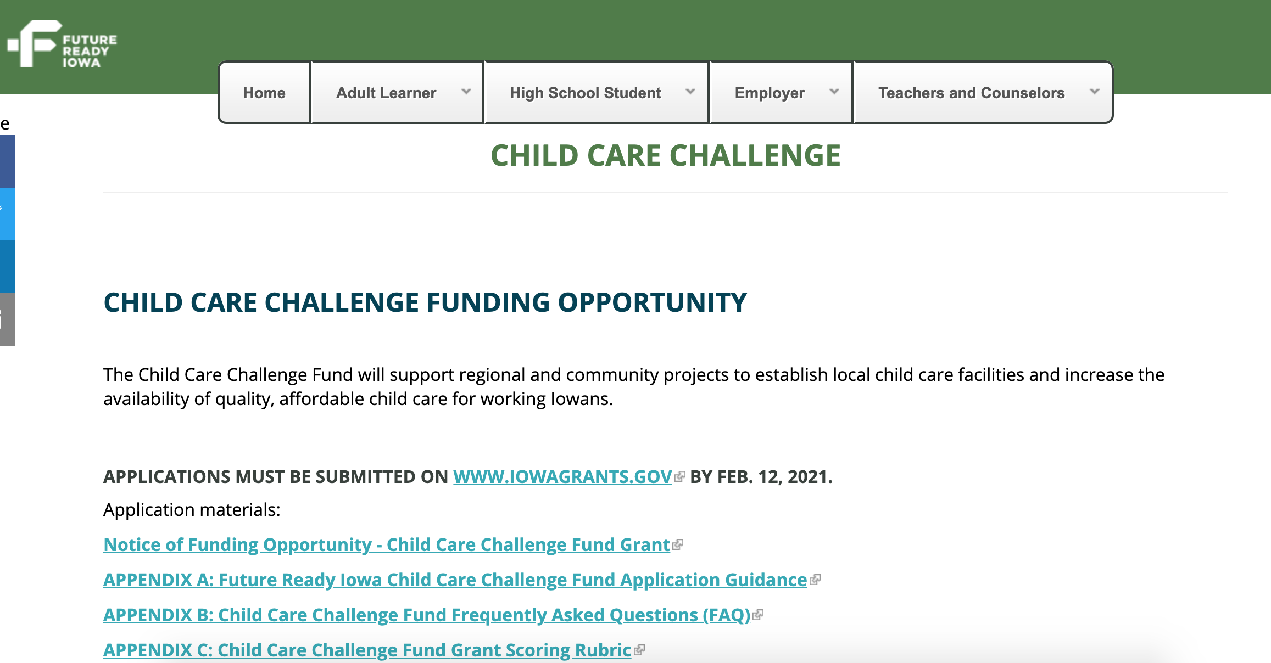
www.FutureReadyIowa.gov/childcarechallenge
FutureReadyIowa.gov/innovation

Slide 25
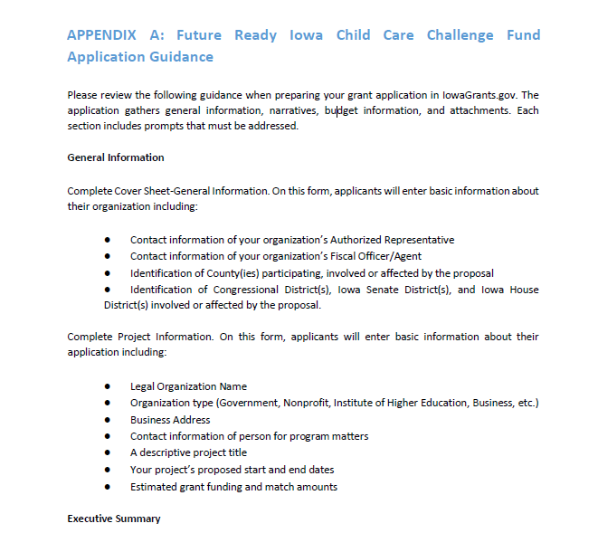
Appendix A

Slide 26
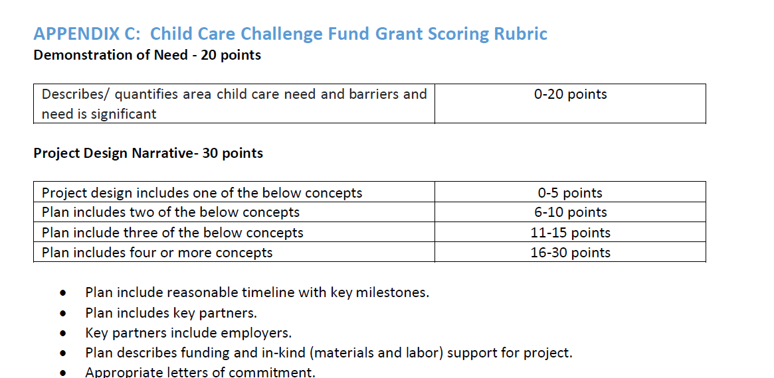
Appendix C

Slide 27
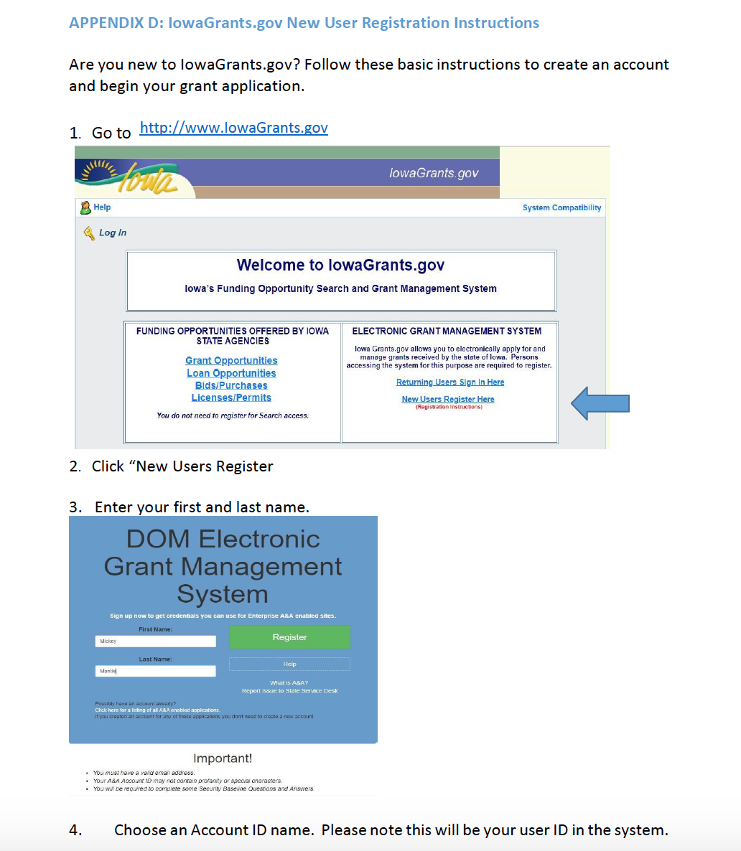
Appendix D

Slide 28
Future Ready Iowa Child Care Challenge
Budget documents
Budget Narrative
Budget Spreadsheet

Slide 29
Future Ready Iowa Child Care Challenge
Questions?

Slide 30
Future Ready Iowa Child Care Challenge Grant
Questions?
Contact
Ryan Page
rpage@dhs.state.ia.us
Kathy Leggett
Kathy.Leggett@iwd.iowa.gov
515-204-1378

Slide 31
UNLEASHING OPPORTUNITIES TO GET IOWA FUTURE READY.

