Slide 1

Benefits planning 101 (2019)
Brian S. Dennis

Slide 2
True or False?
On Disability I can only have $2,000 in the Bank.
If I make more than $1,000 I will lose my Disability benefits.
I have to keep at least $1.00 of SSI to keep my Medicaid.
I have to report my tax refund to Social Security.
The rules for SSI and Disability are the same.
If I lose my benefits (SSDI or SSI benefits) I have to do new application.
Notes:
The answer to the first questions is “False”.
The final answer is “it depends”.

Slide 3
The Big Question
Will I lose my benefits?
  Cash payments
  Health Care
Notes:
Cash Benefits: SSDI/SSI Payments
Healthcare: Medicaid/Medicare

Slide 4

Social Security isn’t all knowing
They base decisions on what you tell them.
Notes:
Depends on timely and accurate reporting for the customer or their supports
SSA has a really big “but”; for most rules there may exist a caveat

Slide 5
Social Security’s Definition of having a Disability
“The inability to engage in any substantial gainful activity by reason of any medically determinable physical or mental impairment which can be expected to result in death or which has lasted or can be expected to last for a continuous period of not less than 12 months.”
Notes:
Explain to participants that the basis for establishing disability is outlined in the definition of disability found in Section 223(d) of the Social Security Act.
If preferred, you can use the following slide to further break the definition down.

Slide 6

Benefits and Going Back to Work
Notes:
SSA looks at returning to work like entering a pool. For most customers; moving from work to off of benefits completely requires multiple small steps.

Slide 7
Disability Benefit Programs
Social Security Disability Insurance (SSDI)
Supplemental Security Income (SSI)
Both SSDI and SSI = Concurrent Benefits

Slide 8
Overview of Social Security Benefit Programs
Title II Social Security Disability Insurance (SSDI)
  Entitlement program based upon insured status
  3 different forms – SSDI, CDB and DWB
  Comes with Medicare coverage
  Amount of benefit varies
  Received on 3rd of month
  Income counted when it’s received.
Title XVI Supplemental Security Income (SSI)
  Funded by federal tax dollars, not Social Security trust fund
  Needs-based program based upon financial eligibility
  Comes with Medicaid coverage
  Set full benefit amount ($771)
  Received on 1st of month
  Income counted when it’s received.
Notes:
SSDI is similar to hitting fast forward on retirement. Someone has paid into the system.
SSI is a needs based (welfare) program. SSI is a “last resort” program. Must be disabled and poor

Slide 9

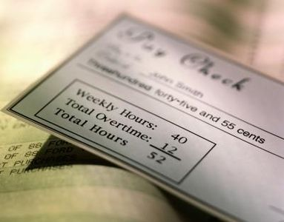
SSDI
Notes:
All or nothing program based on the customer’s earned income.
For SSA’s purposes resources, unearned income, spousal wages, etc. do not matter
May matter very much to DHS (Medicaid, SNAP, CCA)
Can win the lottery and keep SSDI benefits

Slide 10



Social Security Disability Insurance
Three Phases
Trial Work Period -- Income over $850 triggers it for 2019. Allows you to work and still receive benefits. 9 months, non consecutive. NEVER jeopardizes cash benefits
Extended Period of Eligibility – 36 months. Cash benefit determined by whether you earn above or below Substantial Gainful Activity (SGA) – For 2019, $1,220 for non-blind/$2,040 for blind
Expedited Reinstatement – 60 months. Work income over SGA results in termination. A contacting SSA reinstates provisional (temporary) benefits.

Slide 11
Trial Work Period
A 9-month “Trial Work Period”
Income equal to or more $880.00 (2019)
Allows you to work & receive SSDI benefits.
9 months not necessarily consecutive
The amount of income earned NEVER jeopardizes cash benefits
Notes:
Trial Work is how it sounds; SSA wants you to try working.
Trial Work allows you to work and keep you benefits. It’s a house without a roof; but does have a basement.
Months do not have to be consecutive; any TWP month which is over 60 months old is reinstated as long as you have not used all of the 9 service months.
No other work incentives can be used during TWP. For customers who have worked since getting on benefits; a BPQY is needed.

Slide 12

Extended Period of Eligibility
36 months of Extended Period of Eligibility(EPE)
Income less than SGA ($1,220 for non-blind/$2,040 for blind) = cash benefit.
Income at SGA or over = no cash benefit (for 1 month).
3 Grace Period Checks.
Check can be “ceased”.
Medicare continues/Medicaid continues.
Reinstatement is automatic.
Notes:
SSA pays you a month behind.
No one receives their last SSDI benefits payment
Explain the difference between “Ceased” and “Terminated”
On or off for 36 CONSECUTIVE months

Slide 13
What is Expedited Reinstatement
If your benefits ended because you worked and had earnings, you can request that your benefits start again without having to complete a new application. While we determine whether you can get benefits again, we can give you provisional (temporary) benefits for up to 6 months.
Are you eligible?
If you are an SSDI or SSI beneficiary who:
1. Stopped receiving benefits because of earnings from work,
2. Are unable to work or perform substantial gainful activity,
3. Are disabled because of an impairment(s) that is the same as or related to the impairment(s) that allowed you to get benefits earlier, and
4. Make the request within 5 years from the month your benefits ended.
Notes:
Termination only occurs (due to wages) once you have exhausted your EPE (36 months) and work at SGA level or higher one more time. Some customers will be in “EPE” for several years because they have not worked at SGA past the 36 months.
To find out when EPE started and ended; you will need a BPQY
Can request multiple EXR’s

Slide 14
Other SSDI Work Incentives
Impairment Related Work Expense (IRWE)
Out of pocket costs needed to work:
  Supported employment services
  Attendant care services
  Special transportation
  Medical support devices
  Counseling and medication
  Work equipment
  Over the counter items
  Etc.
Subsidy or Special Conditions
  Participants “earn” less than 100% of their wages
  Participants receive additional assistance
Notes:
IRWEs are best reported on an IRWE form. Think of IRWEs like SSA Flex Plans.
Subsidies are the easiest to request. Is a one-time process.
Special Conditions are usually seen as Job Coaches

Slide 15
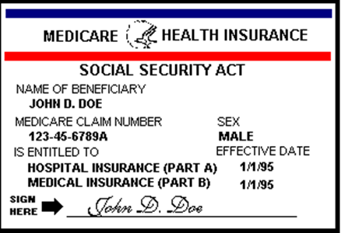
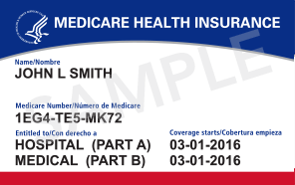
What happens to Medicare if SSDI benefits stop?
Continues for at least 93 months (7 years and 9 months) after the 9 month Trial Work Period
After that you may be able to purchase Medicare coverage
Notes:
The 93 months of EMPC will be for Medicare Part A
Can purchase beyond EPMC

Slide 16
Medical Benefit Associated with SSDI
Medicare
  Title II beneficiaries
  SSDI for 24 months
  Other disabilities may receive benefit immediately such as, Kidney failure or Amyotrophic Lateral Sclerosis (Lou Gehrig’s Disease)
Four parts
  Part A – Hospitalization (free)
  Part B – Dr. Services, medical services, supplies ($130)
  Part C – Medicare Advantage Plans
  Part D – Prescription Drug Plans
Notes:
Part A:
Inpatient care in a hospital
Skilled nursing facility care
Inpatient care in a skilled nursing facility (not custodial or long-term care)
Hospice care
Home health care
Part B:
Clinical research
Ambulance services
Durable medical equipment (DME)
Mental health
Inpatient
Outpatient
Partial hospitalization
Getting a second opinion before surgery
Limited outpatient prescription drugs

Slide 17
Medicaid for Employed People with Disabilities (MEPD)
Must be disabled
Must have earned income from employment
Must be under age 65
Must meet income and resource requirements (higher than SSI requirements)
Same as Title 19 - administered by DHS
Some individuals may pay a premium
Higher resource limit ($12,000/$13,000)
Iowa MEPD Website
Notes:
In Iowa due to the Managed Care Organizations; you card will come from:
Amerigroup
United Healthcare
Iowa MEPD website: https://dhs.iowa.gov/ime/members/medicaid-a-to-z/mepd

Slide 18


Supplemental Security Income (SSI)

Slide 19
SSI Benefits
Needs-based
Paid out of general federal tax dollars
Meant to provide enough $ for basic food and shelter
Comes with Medicaid/Title 19
Notes:
On SSI you must pay for Rent or you will have 1/3rd of your check reduced.

Slide 20
Basic Eligibility for SSI
Aged 65 or older;
Blind (20/200 or less in better eye with glasses or field of vision less than 20 degrees); or,
Disabled; and
Meet the income and resource tests; and
Certain citizenship or residency requirements.
File an application.
Iowa Medicaid Website
Notes:
There is a paper and online application
Iowa Medicaid Website: https://dhs.iowa.gov/how-to-apply

Slide 21
Federal Benefit Rate (FBR)
Rate set each year by SSA
Receive the full FBR when responsible for food and shelter; and little to no income.
2019 Rates:
Individual: $771
Eligible Couple: $1,157
Notes:
If 2 INDIVIDUALS s each receive SSI benefits of $1,542 per month
One couple receives $1,157 per month
Almost a $400 per month difference
Holding out as eligible couple (bills, leases, tax returns, introductions)

Slide 22
Income That Impacts SSI
Unearned income
Gross wages/earnings and net earnings from self-employment, including in-kind items received in lieu of wages (like room and board)
In-kind support and maintenance received from others

Slide 23
Unearned Income and SSI
Common forms of unearned income would include the following:
Social Security Title II benefits (SSDI)
Veteran’s benefits
Worker’s Compensation
Unemployment Insurance
Child Support
Family Investment Program

Slide 24
What is NOT Considered to be Income
Any item that is not food or shelter and cannot be used to obtain food or shelter
  Examples:
    Housing Subsidy (Section 8/PH)
    Income tax refunds
    Proceeds of a loan
    Payment of an individual’s bills that are not for food or shelter items
    Clothing

Slide 25
Resource Limits
Individual’s countable resources must not exceed $2,000 as of the last day of a given month.
Eligible couple’s countable resources must not exceed $3,000 as of the last day of a given month.
Unless on MEPD. ($12,000/13,000)
Notes:
Customers have the calendar month to spend the money down.

Slide 26
Common Resource Exclusions
Household goods and person items
Medical device and equipment
Some life insurance policies
The home where the customer lives
One automobile per customer
Some burial funds, burial spaces, and life insurance assigned to funeral provider
Some student financial assistance
Individual Development Accounts (IDAs)
Some trusts
Support from programs such as DHS and Housing

Slide 27
How earnings affect SSI payments
SSA counts less than half of your earned income
SSA does not count the first $20 of any kind (monthly)
SSA does not count the first $65 of earned income (monthly)
Certain impairment related work expenses can also be deducted from your gross wages.

Slide 28
Calculation of SSI w/earned income only
$885 Earned Income
-20 General exclusion
$865
-65 Earned Income Exclusion
$800
/2 ½ remaining earnings
$400 Countable earnings
$771.00 Federal Benefit Rate- 2019
-400.0O Countable earnings
$371.00 SSI payment
+ $885 gross income =
$1,256.00 Total Gross Income
2-MONTH LAG
*MAGIC NUMBER $1,627 per month (for most people)
Notes:
2-month lag:
January impacts March
February impacts April
November impact January

Slide 29
What happens if my earnings are so high that my SSI stops?
Benefits can start again if you stop working or your earnings decrease (12-month ineligible grace period)
If your earnings are so high that your SSI payments stop:
Medicaid continues until you earn above a threshold ($33,261); this is called 1619b
People with high medical costs can earn even more
Notes:
Earnings are typically annualized; once your monthly income would equal the annual level; 1619b may end.

Slide 30
SSI and Work Incentives
Student Earned Income Exclusion (SEIE)
Impairment Related Work Expense (IRWE)
Blind Work Expenses (BWE)
Plan for Achieving Self-Support (PASS)

Slide 31
Student Earned Income Exclusion (SEIE)
To qualify for this exclusion, an individual must be:
  under age 22; and
  a student regularly attending school/training
  Excludes per Month: $1,870.00
  Excludes per Year: $7,550.00
Notes:
Spotlight on SEIE: https://www.ssa.gov/ssi/spotlights/spot-student-earned-income.htm
Ideal for summer jobs as well.

Slide 32
Blind Work Expenses
Anything considered and IRWE plus
  Service animal expenses
  Transportation to and from work
  Federal, state and local income taxes
  Social Security taxes
  Attendant care services
  Visual and sensory aids
  Translation of materials into Braille
  Professional association fees
  Union dues

Slide 33

Plan for Achieving Self Support (PASS)
Allows an individual to set aside income and/or resources
for a specified period of time to achieve their
vocational goal.
Notes:
Social Security Administration
PASS Cadre
100 Centennial Mall North, Ste. 240
Lincoln, NE 68508
Ph: 866-592-1755 x 23014
Fax: 402-437-5864
kc.region.pass.cadre@ssa.gov

Slide 34
Examples of PASS Expenditures
Supported Employment services
Items & Capital for starting a Business
Educational & Training expenses
Attendant Care
Child Care
Equipment or tools
Uniforms or special clothing
Vehicle Purchases
Etc.

Slide 35

If you get both SSI & SSDI
All of the work incentives apply
Notes:
Definitely refer to a Certified Benefits Planner

Slide 36
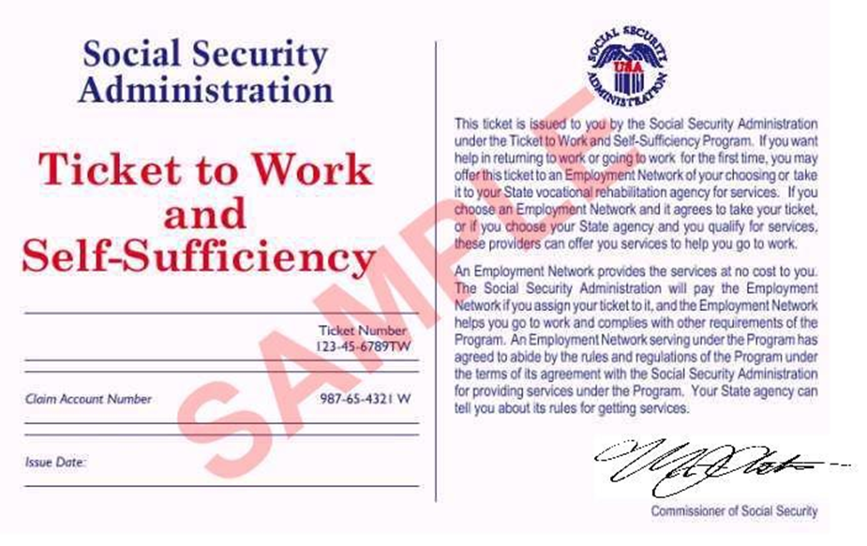
What is a Ticket to Work?
A ticket you can use to get free employment services

Slide 37
Why Assign Your Ticket
No medical review while ticket is in use and making timely progress
Provides $ for additional services for persons with a disability
The program is voluntary
You can always change your mind
Notes:
Timely Progress: https://yourtickettowork.ssa.gov/program-operations/requirements.html

Slide 38

Things to remember
Everyone can work
You can work and maintain benefits
You can gradually transition off benefits
You can maintain your Medicare/Medicaid
ALWAYS reports wages to SSA, get receipt
Assign T2W
Notes:
All IowaWorks office are Employment Networks

Slide 39
True or False?
On Disability I can only have $2,000 in the Bank.
  Only applies to SSI Recipients. Can be raised through MEPD
If I make more than $1,000 I will lose my Disability benefits.
  This refers to the SGA (SSDI); which $1,220.00 or $2,040.00.
I have to keep at least $1.00 of SSI to keep my Medicaid.
  Absolutely not; even if you receive $0.00 in SSI you can make $33,261 per year.
I have to report my tax refund to Social Security.
  No. SSDI does not count unearned income. SSI has already counted the funds.
The rules for SSI and Disability are the same.
  Duh. ☺
If I lose my benefits (SSDI or SSI benefits) I have to do new application.
  If benefits are lost by working; only after the EXR period has expired.

Slide 40
Which is Which (Last Pop Quiz)
3 Magic Questions:
  When do you (usually) receive your check?
    1st (SSI)
    3rd or a Certain Wednesday (SSDI)
  How much is your check?
    $771 or less (SSI)
    More than $771 (SSDI)
  How many checks do you receive?
    1 (SSI or SSDI)
    2 (Concurrent: SSI and SSDI)

Slide 42
Thank you.

