Slide 1
Month Date, 2018
Disability Access Committee
Rosie Thierer, Executive Officer - Iowa Department on Aging

Slide 2
Tapping into the
Experience of the Older Worker

Slide 3
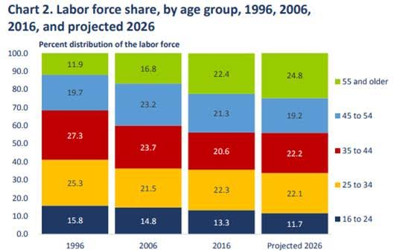
BLS Projections
Every group shrinking except older worker

Slide 4
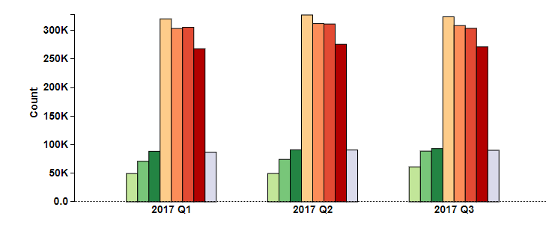
Iowa Numbers 2017-All Industries
Iowa 2017

Slide 5
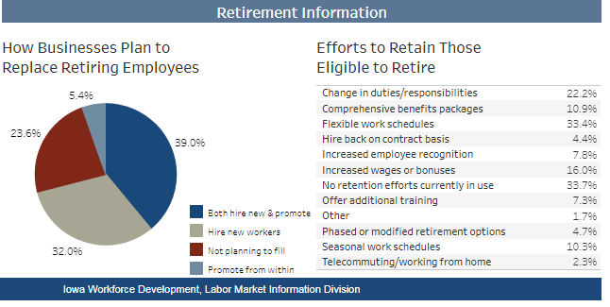

Slide 6
Why Are All These People Still Working or Looking for Work?
Laid off (Mid-fifties hardest)
No defined pension – not afford to retire
Paying off student loans - their own or children
Caring for grandchildren
Access to health care or need to pay off large medical bills even with Medicare coverage
Just released from prison
Want to remain engaged and have sense of purpose

Slide 7
Why Our Assistance is Needed
Still unemployed after 12 months
Age 62+ 62%
50-61 47%
35-49 39%
25-35 35%
Myths about hiring older worker keep them unemployed longer.
Urban Institute

Slide 8
What We Can Do For:
Job Seekers
and
Businesses

Slide 9
Check Beliefs and Attitudes-Unconscious Bias
When we are faced with an “older worker” we are reminded of our own aging which is something most of us prefer to avoid.
Our biases start to appear:
Start speaking louder and slower
Assume cannot use a computer
Don’t recommend training programs because they are not interested in learning

Slide 10
Start Myth Busting
Older workers can’t keep up
BLS finds no difference in hours worked by younger and older workers
At age 50+ evidence that older workers more motivated to exceed expectations
Unwilling to share job knowledge
Used to working as team work at transferring what know
More costly due to higher salaries, health benefits, vacations
Cannot only look at costs must also look at economic value
Cannot learn new skills
This age fastest growing group of internet and social media users

Slide 11
Myth Busting cont.
Won’t stay on job long if hire and train because they will retire soon
Age 55-64 worked at company 10.1 years
Age 25-34 2.8 years
Older workers are not as flexible or adaptable
Just as adaptable as younger workers
May question why changes are made but will go along if rationale is explained
Take more sick days
Attendance better for older worker than younger ones
Older workers more prone to injury/disability
No data to support this rather tend to experience fewer workplace injuries
Disability based on risk factors-current older workers healthiest have ever been

Slide 12
Upskill Older Worker
Offer assessments to help understand strengths
Assist with producing new resume that “hides” age
Help understand how job search has changed
Provide training on interviewing skills
Assess their network and help them understand how to use it
If need computer skills training help them identify a reason to take classes
Point them to certificate training that might help them along a career path
Connect them to businesses for informational interviews/internships
Believe that they can find employment

Slide 13
Educate Business
Become an Age Friendly Workplace by:
Embracing the benefits of older workers
Leadership skills, communication skills, focused, strong-work
ethic, not looking for next opportunity, strong networks
Remove ageism from job ads - Recent Grad, Ninja, Energetic
Incorporate images of mature worker in marketing materials
Train middle managers/supervisors in how to work with multi- generational workforce
Use multi-generational work teams
Provide mentoring/reverse mentoring programs
Bring in older worker for internship
Move older worker to skills training positions

Slide 14
Business Education cont.
Suggest alternatives pathways to retirement
Full-time to part-time
Job Sharing
Job floater where serve as mentor for newer workers
Create list of and pathways for retirees wanting to return for special projects
Provide open environment to request accommodations for arthritis, high blood pressure, diabetes, and other age related conditions
Provide access to classes on nutrition, exercise, etc. to reduce disability risk factors
Wellness programs
Design flexible leave policies for care-giving
Make sure welcoming environment for all ages
Assist with job analysis to list skills needed for job and adaptations or accommodations that could be used

Slide 15
References
Managing the Older Worker-Peter Cappelli and Bill Novelli
Harvard Business Press 2010
Aging and Disability: Beyond Stereotypes to Inclusion: Proceedings of Workshop
http://nap.edu/25029
America’s Aging Workforce: Opportunities and Challenges-Special Committee on Aging United States Senate December 2017
https://www.congress.gov/115/crpt/srpt191/CRPT-115srpt191.pdf
SHRM The Aging Workforce: Leveraging the Talents of Mature Employees
https://www.shrm.org/hr-today/trends-and-forecasting/special-reports-and-expert-views/Documents/Aging-Workforce-Talents-Mature-Employees.pdf
More Than a Number, Kate Rockwood, HR Magazine February 2018

Slide 16
Rosie Thierer
Iowa Department on Aging
rosemary.thierer@iowa.gov
515-776-8115
Thank you.

