Slide 1
October, 2018
Purple VRI Instructions
Kylie Murphy, Disability Resource Coordinator

Slide 2
What is Purple VRI?
Video Remote Interpreting (VRI) allows communication between deaf or hard of hearing clients and service providers
The hearing individual talks to the deaf/hard of hearing person, while the Video Interpreter (VI) signs what is being said
Interpretation continues throughout the meeting to ensure seamless conversation

Slide 3
Benefits
Works with internet/WiFi
Compatible with computers and webcams as well as tablets that have cameras
Accounts and agreements are easy to set up and access
Available 24/7
Certified ASL interpretation
Per minute pricing
ADA/HIPPA Compliant
Technical support is included

Slide 4
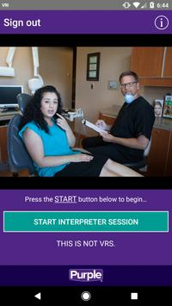
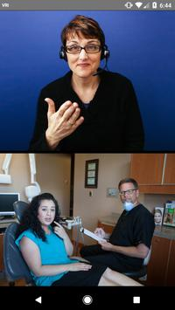
How to use it:
Use a quiet, private location
Stand or sit beside or close to the video screen
Open the application
Log in using your region/agency log in credentials
Select “Start Interpreter Session”
Introduce yourself and individual to the interpreter
Provide the interpreter a brief topic overview that will be discussed

Slide 5
Tips:
Ensure that the device is charged/plugged in
The interpreter may begin to sign to the client to ensure they are a good match
The interpreter may ask you to move or adjust equipment if needed
The interpreter will greet you when the session begins
There may be a delay between what you speak and the translation, the interpreter will let you know if you need to slow down
The hearing individual should be near the microphone and the deaf/hard of hearing individual should be in front of the camera
Look and speak to the deaf/hard of hearing individual

Slide 6
Questions?
Thank you.

